Slide 1

How to perform a SQL Server Health Check
Carlos Robles
Principal Consultant, DBA Mastery

Slide 2





Experience
Over 10 years of experience as DBA
Multi platform DBA
Linux, Windows, Virtual & Cloud environments
Oracle, SQL Server, MySQL, Azure SQL DB
MCSE Data management and analytics
Community
Speaker, Guatemala SSUG group leader, blogger, author, mentor, volunteer, like to help people in Twitter using #SQLHelp hashtag.
DBA Mastery
SQL Server tips, scripts, best practices and more.
MAXDOP Calculator - GitHub
Carlos Robles
Principal Consultant, DBA Mastery
/croblesdba
@dbamastery
dbamastery@gmail.com

Slide 3
Agenda
Introduction
What is a SQL Server Health Check?
Reasons why I should perform it?
When should I perform it?
How can I perform it?
Quick demo

Slide 4
Introduction

Slide 5
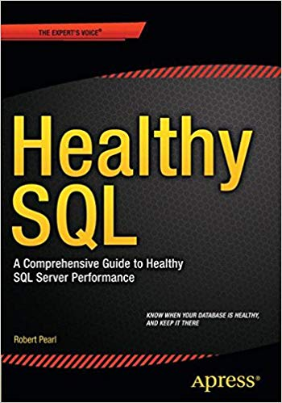
Every engine needs tuning, your database is not different ….
Robert Pearl
Is your entire SQL Server environment healthy?
How do you know?
Are you able to provide detailed information about your SQL Server instances?
Notes:
Car analogy
Question about audience, DBAs, Developer DBA, Other

Slide 6
What is a SQL Server Health Check?

Slide 7

SQL Server Health Analogy:
Front desk collects basic information
Doctor collects information by asking questions and performing tests
Doctor analyzes the information
Doctor provides a diagnostic
Doctor provides some medicine
Notes:
Doctor analogy

Slide 8
SQL Server Health Check process
Basic documentation
Compare against best practices
Write up Health Check results
Collect detailed data
Analyze \ categorize data
Implement changes
Monitoring changes
Baseline

Slide 9
Reasons why I should perform it?

Slide 10
Is the DBA work to maintain the environment healthy
Provides documentation and a baseline for:
Performance Tuning
Troubleshooting
Disaster Recovery (Rebuild)
Encourages proactive work
Environmental stability
Standardization

Slide 11
When should I perform it?

Slide 12
Once starting in a new job, to quickly learn about the SQL Servers you have inherited and now “own”.
Once an initial health check is performed, it should be repeated regularly to ensure the continued health of your SQL Servers.
Follow-up health checks will be much faster because you already have collected the basics.

Slide 13
How can I perform it?

Slide 14
Built-in tools
PerfMon
Event Viewer
SCOM
OMS
MAP
SSMS
DMVs
PSSDiag \ SQLDiag
Query Store
System Health Session Monitoring
Xevents
PowerShell

Slide 15
Open Source tools
PAL - Clint Huffman
dbatools - Chrissy LeMaire
dbachecks - Rob Sewell
BPCheck - MSSQL Tiger Team
Diagnostic Information Queries - Glenn Berry
SQLDiagCmd - Mich Wheat
First Responder Kit - Brent Ozar Unlimited
SQL Nexus - Jack Li

Slide 16
Demo

Slide 17
Recap

Slide 18
SQL Server Health Check process
Basic documentation
Compare against best practices
Write up Health Check results
Collect detailed data
Analyze \ categorize data
Implement changes
Monitoring changes
Do it again …
Baseline

Slide 19
SQL Server Health report sections
Hardware
Operating system
Backups
SQL Server settings
SQL Server patching
Database settings
Performance tuning
Maintenance routines
Monitoring
Security
High Availability

Slide 20
Questions

Slide 21

Resources
www.dbamastery.com
https://git.io

Slide 22
Thank you!!!
/croblesdba
@dbamastery
dbamastery@gmail.com

